Slide 1
Team 16 - Safe AI-Powered Canvas Workflow Assistant
PROOF OF life Presentation
Capstone Project - AI-Assisted Canvas LMS Workflow Management
Presented by team 16

Slide 2





MEET THE Team
YERDANA MAULENBAY
MRIDUL NOHRIA
BAO TRAN
JESSICA GOEL
RHYTHM TRIVEDI

Slide 3
Project Purpose & Problem Statement
Instructors spend excessive time navigating Canvas for repetitive workflows
Tasks like missing submission tracking and messaging require multiple manual steps
Administrative overload reduces time available for teaching and student support
Goal: simplify workflows using conversational AI assistance

Slide 4
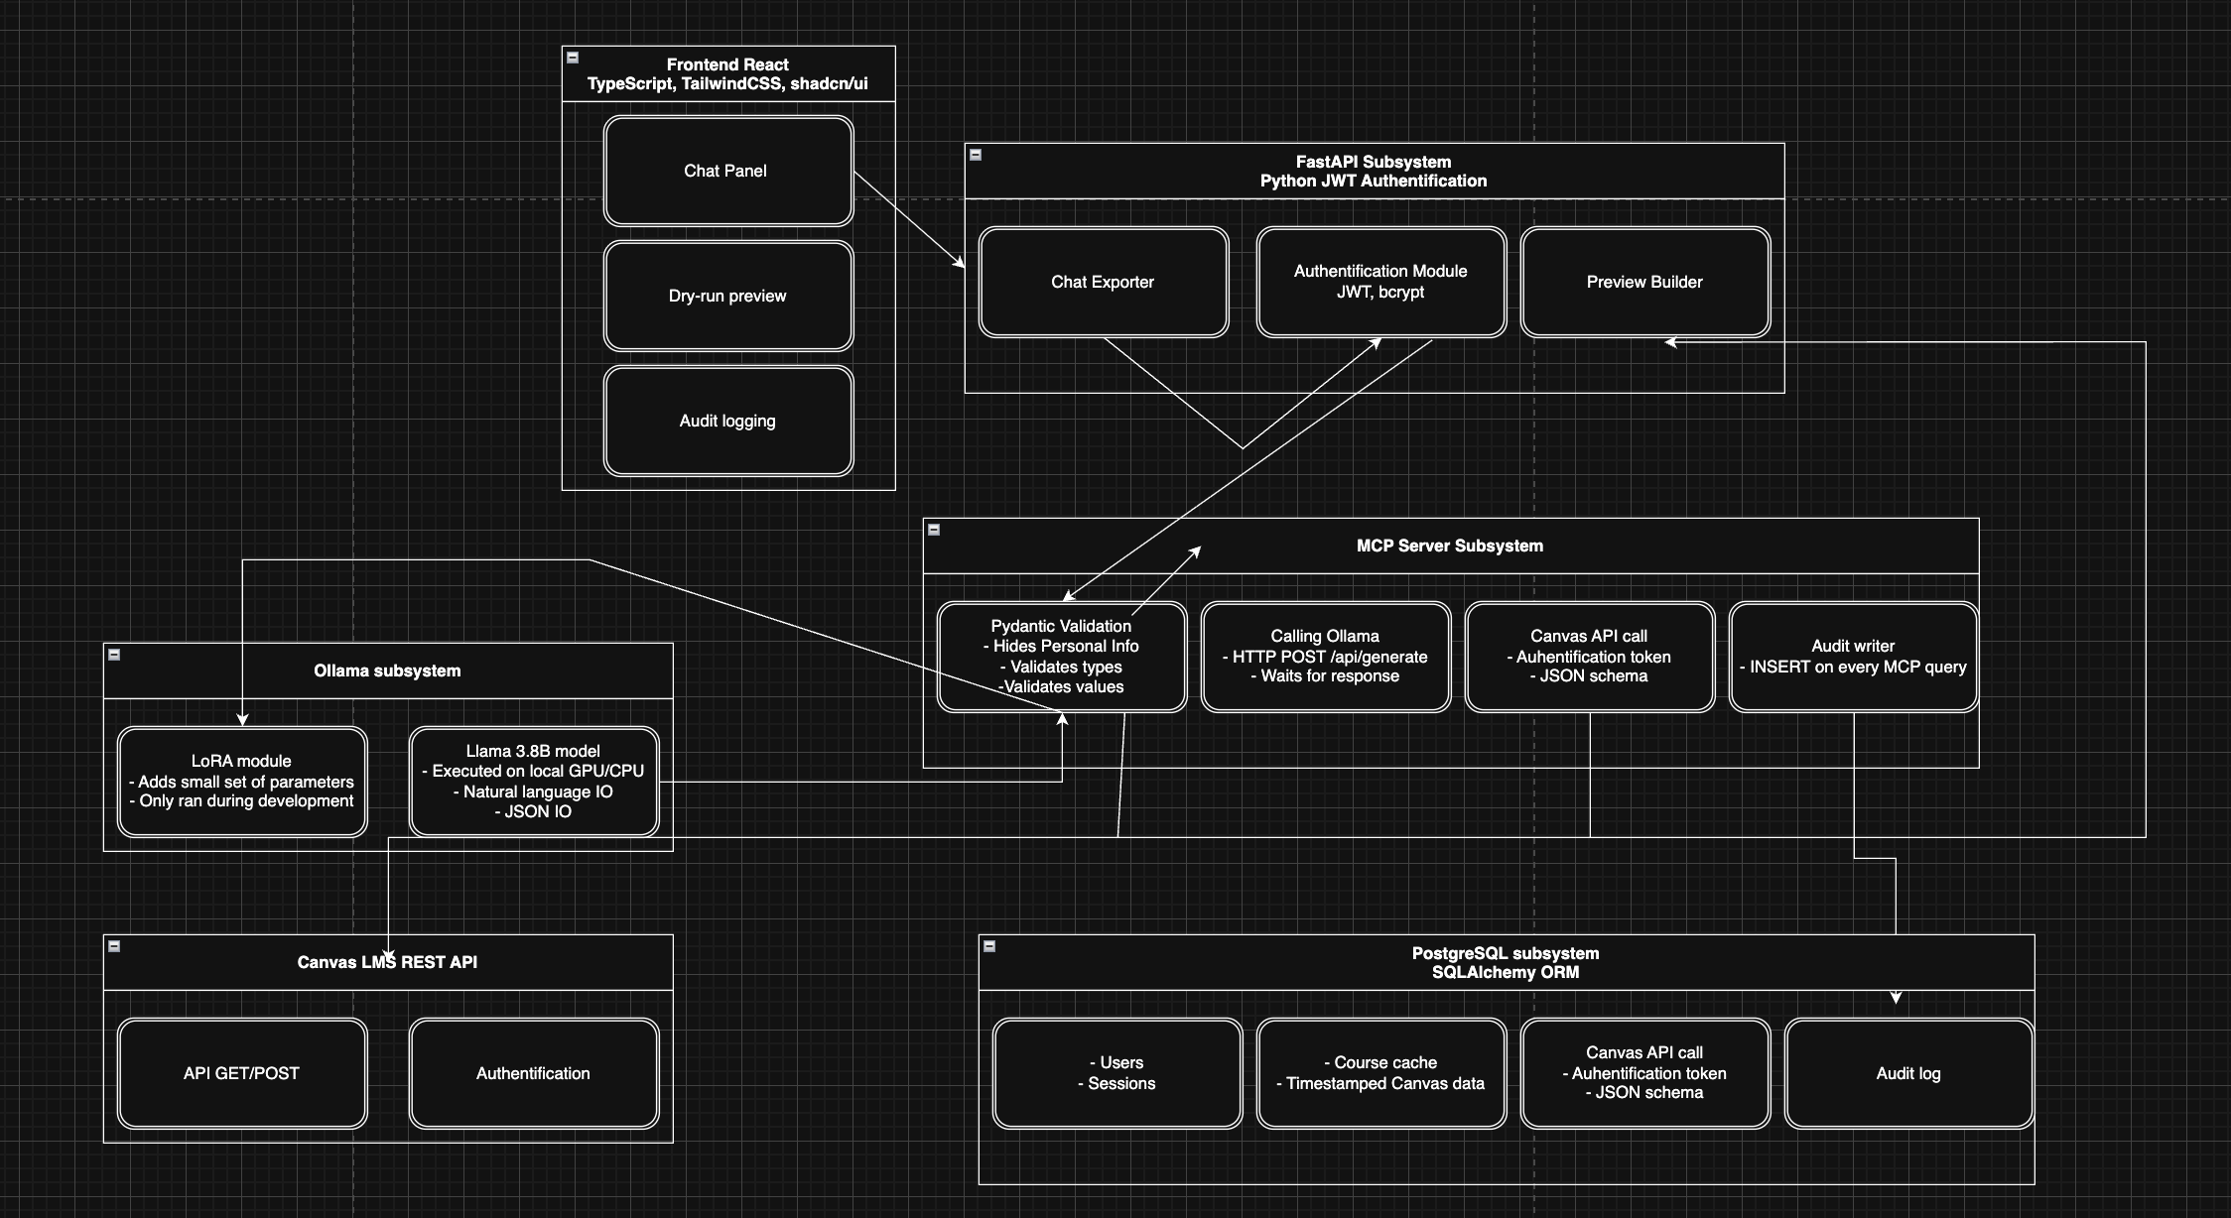
System Architecture
Frontend
React
TypeScript
Tailwind
Backend
FastAPI
MCP Server
Infrastructure
PostgreSQL
Ollama
Canvas LMS
Key design
decisions:
Local AI
Secure credential
boundary
Human approval
workflow

Slide 5
Features Implemented
Registration
Login
JWT Authentication
Backend API Endpoints

Slide 6
Features In Progress
Canvas Integration
AI Workflow Generation
Workflow Preview
Audit Logging
Dashboards

Slide 7
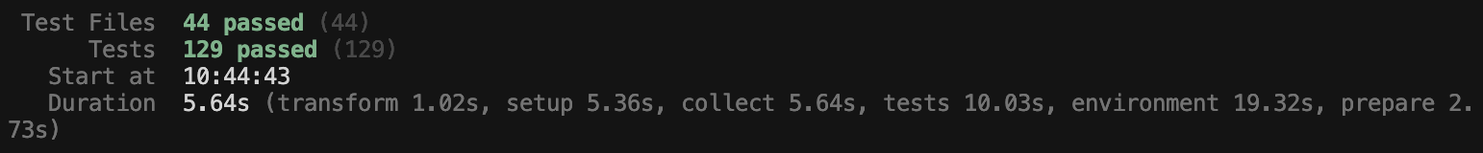
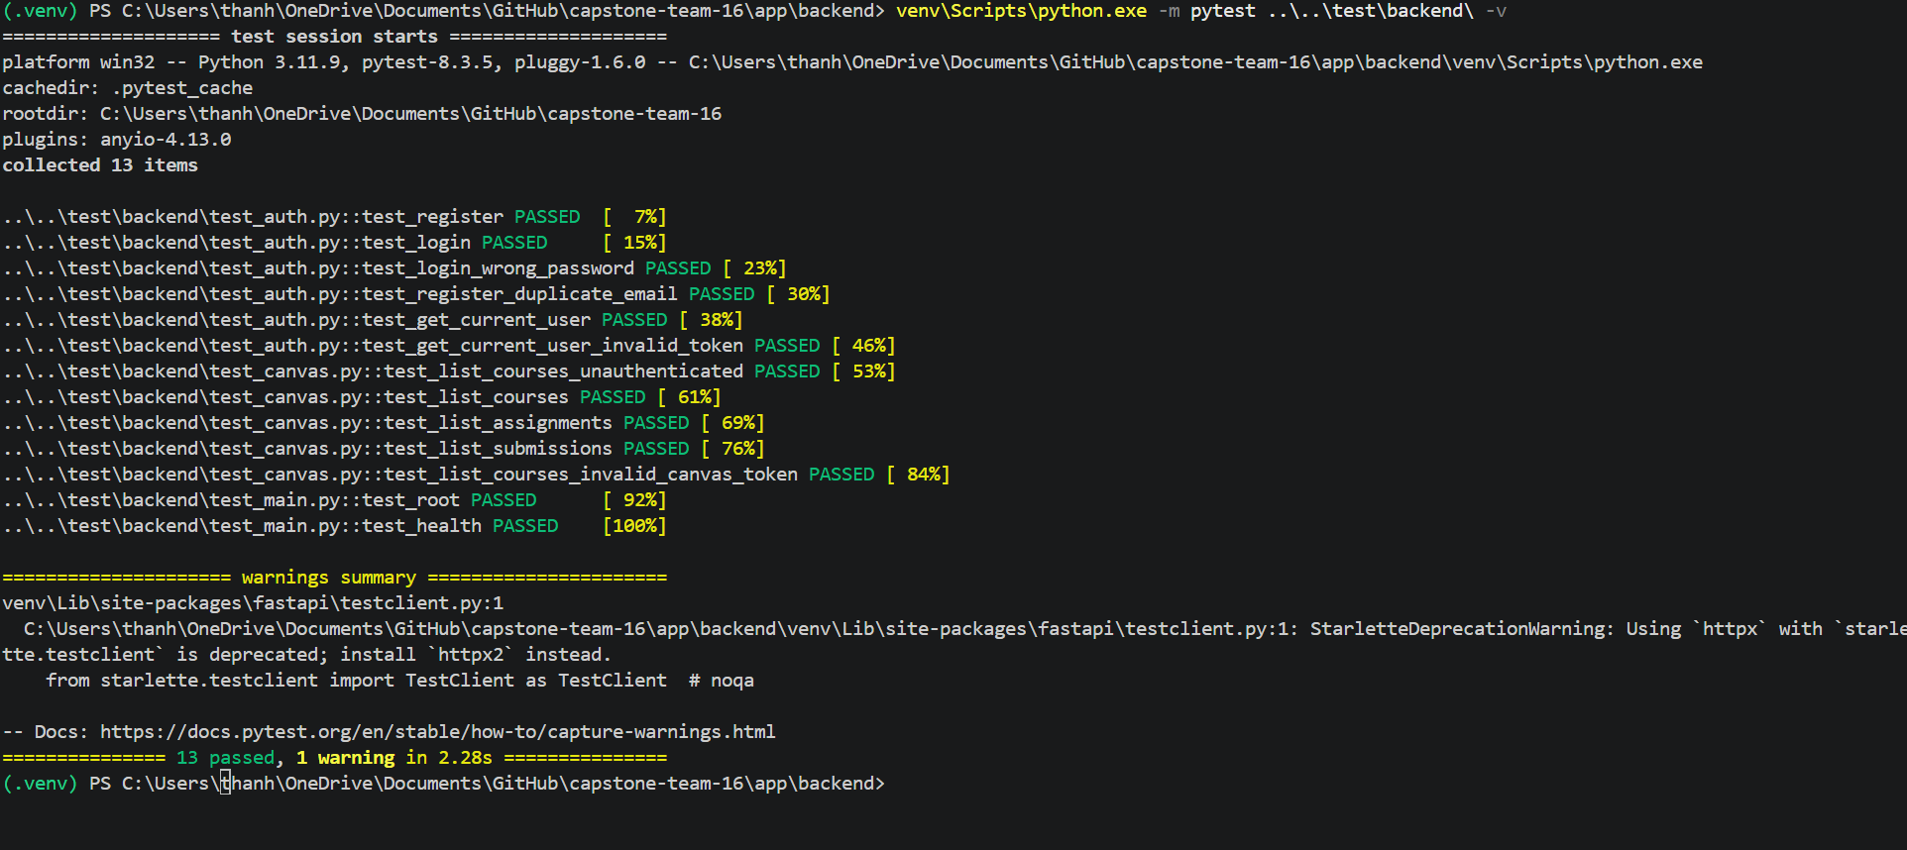
Testing
Frontend:
Backend:

Slide 8
LIVE DEMO

Slide 9
CHALLENGES AND NEXT STEPS
Challenges
Canvas API integration
Local LLM integration
Security considerations
Authentication setup
Next Steps
Complete Canvas integration
Implement workflow preview
Add audit logging
MVP Demo preparation

Slide 10
Q AND A SESSION

Slide 11
THANK YOU

